Slide 1
Dynamic Systems

Slide 2


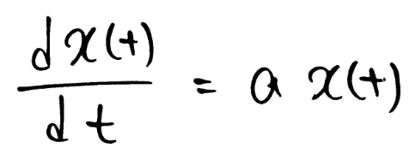
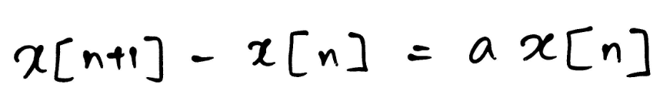
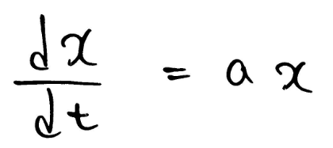
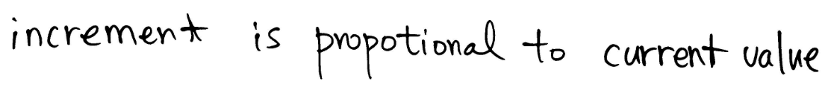
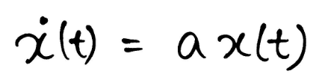
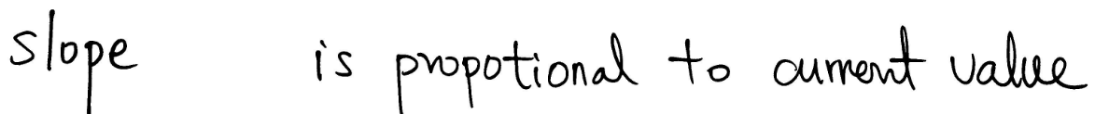
Dynamics Systems

Slide 3
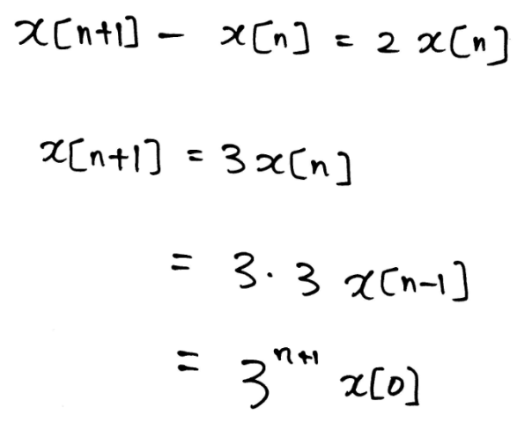
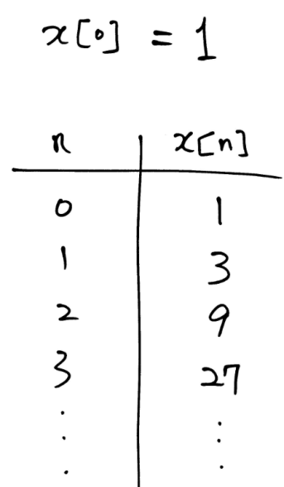
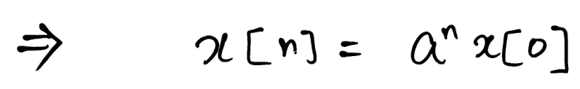
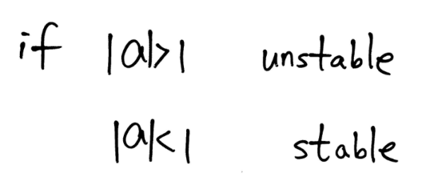
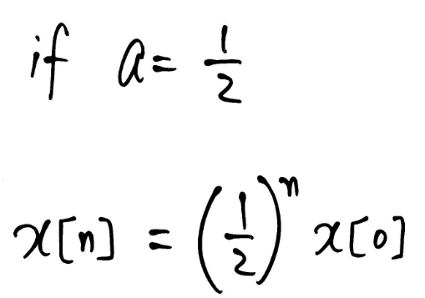
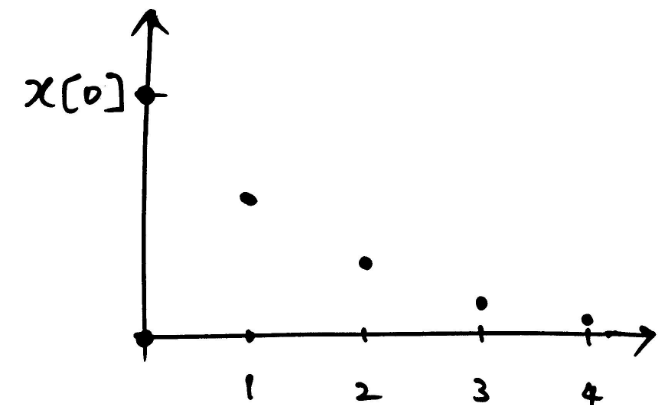
1ST Order ODE

Slide 4
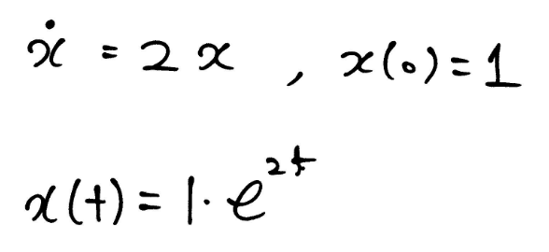
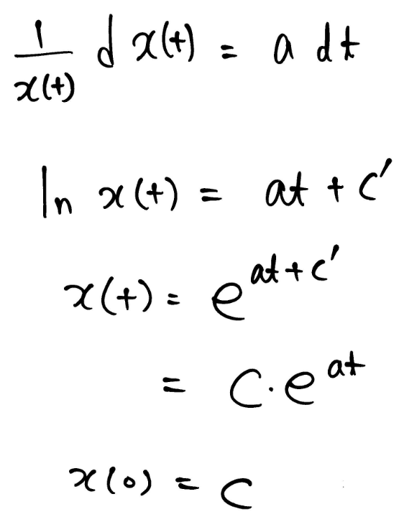
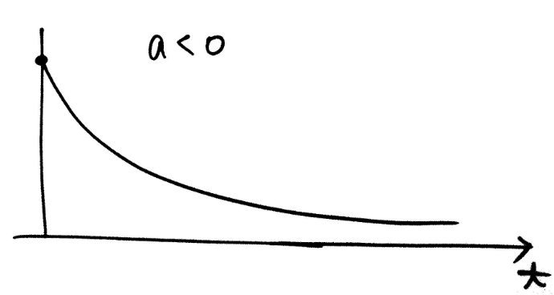
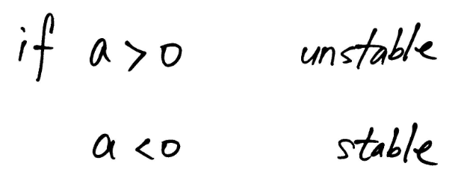
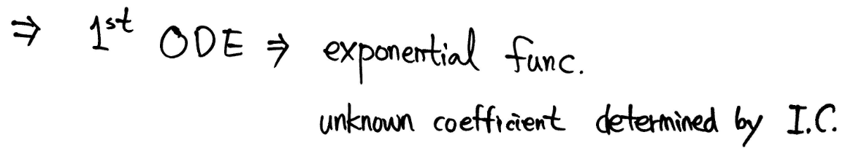
1ST Order ODE

Slide 5
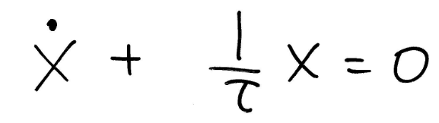
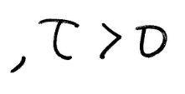
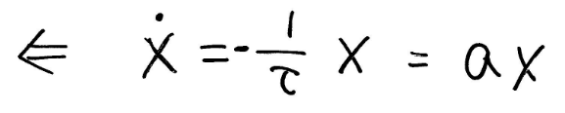
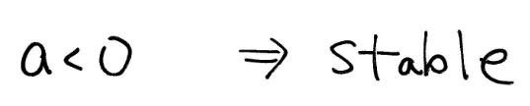
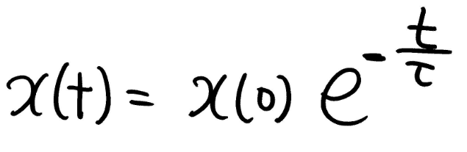
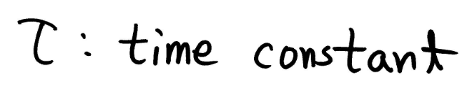
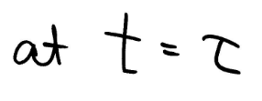
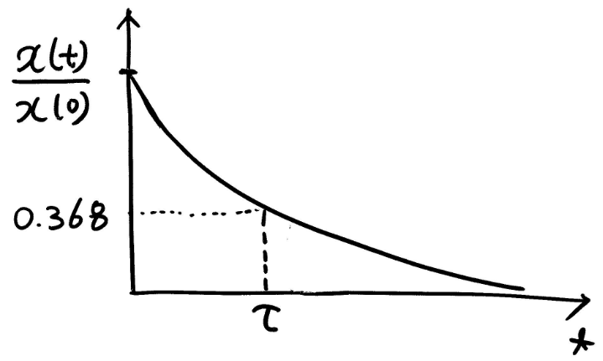
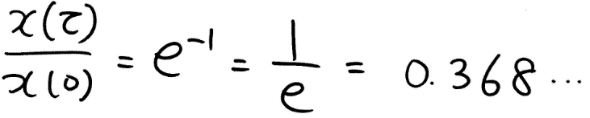
1ST Order ODE in Circuit
Large τ → slow response
Small τ → fast response

Slide 6

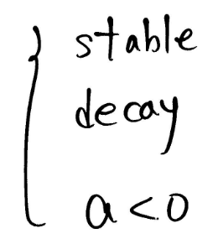
Natural Dynamic Systems

Slide 7
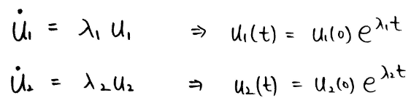
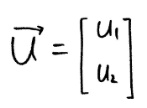

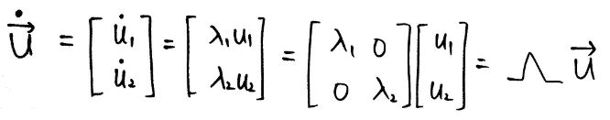
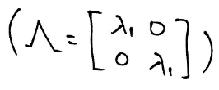
Two 1st Order ODEs (Independent)

Slide 8
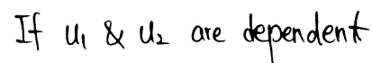
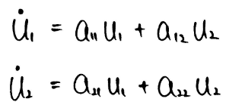
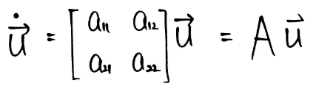
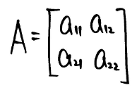
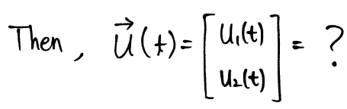
ODE in Vector Form (Dependent)

Slide 9
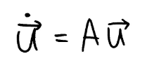
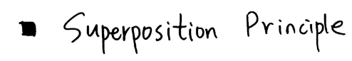
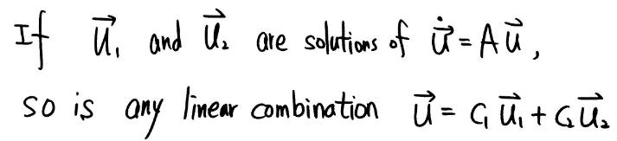
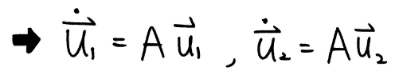
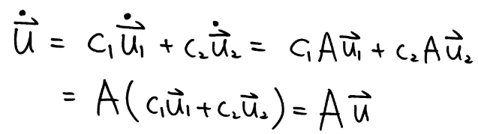

Slide 10
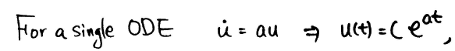
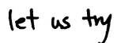
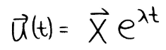
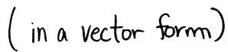
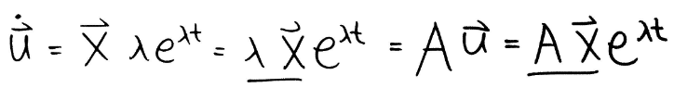
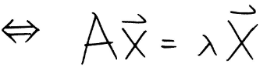
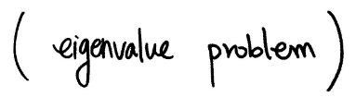
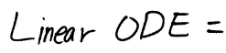
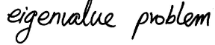

Slide 11





General Solutions

Slide 12









Initial Condition Decompose

Slide 13








Slide 14









Example 1

Slide 15






Example 1

Slide 16









Slide 17




Example 2

Slide 18





Slide 19












Slide 20



Slide 21






v-frame is decoupled by

Slide 22










Example

Slide 23







independent

Slide 24








Slide 25






Slide 26







Slide 27





Slide 28






Slide 29






Slide 30





Slide 31








Slide 32
Dynamic Systems 2

Slide 33





Example 1

Slide 36





Example 2
Think of advertising budgets for city 1 and city 2
Physical meaning !!!

Slide 37

Why?

Slide 39






Different Matrices with the Same Eigenvalues
Sketch
Sketch
Sketch
Decoupled

Slide 40






Example 3

Slide 41

Sketch Trajectories with Various I.C.s

Slide 42



Change Variables

Slide 43


De-coupled

Slide 44
Trajectory Comparison

Slide 45
Dynamic Systems 3

Slide 46
Decoupling

Slide 47






Decoupling

Slide 48






Decoupling

Slide 50
v-frame is decoupled by

Slide 51
Example

Slide 52
independent

Slide 53
Trajactory

Slide 54
Complex Eigenvalues

Slide 55
Complex Eigenvalues

Slide 56
Example – Pure Imaginary

Slide 57
Example

Slide 58
Trajectory

Slide 59
Example – Pure Imaginary

Slide 60

Example

Slide 61
Trajectory

Slide 62
Example – Pure Imaginary

Slide 63
Trajectory

Slide 64
Example – Complex Number

Slide 65
Trajectory

Slide 66



What is the Corresponding Physical Systems?

Slide 67
Simple Harmonic Motion
Which one is a displacement?
Which one is a velocity ?
Does not decay.
Is it true?

Slide 68

Spring and Damping Experiment

Slide 69









Slide 70






Physical interpretation

Slide 73
Under Damping & Over Damping
Under damping
Over damping

Slide 74
Damping Ratio

Slide 75
Dynamic Systems 4

Slide 76









First Order Differential Equations

Slide 77


Response Speed & Time Constant
1/e
1/e
1/e
No, it cannot have complex eigenvalues

Slide 78



Response of the Second Order Differential Equations
Homogeneous ODE

Slide 79




Response of Non-zero Constant Input (Right Side)
Inhomogeneous ODE
Same dynamics, but it reaches different steady state
Good enough to sketch

Slide 80



Transient + Steady State
Dynamic system response = transient + steady state
Transient response is present in the short period of time immediately after the system is turned on
The system response in the long run is determined by its steady state component only.

Slide 81





Sketch X(t)
So far, homogeneous ODE

Slide 82









Example of Inhomogeneous ODE
if

